Slide 1
Project 2
Pejal Rath

Slide 2

Introduction

Slide 3

Why retaining talented employees is important for a company's success?
Cost Savings
Increased productivity
Improved morale
Better customer service

Slide 4
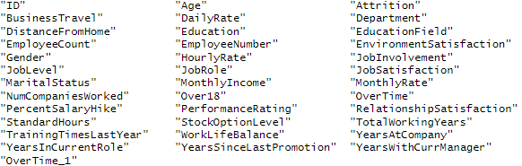
Data Overview
The dataset contains a list of 870 employee data.

Slide 5

Attrition- Top Three Factors
Age
Over Time
Job Involvements

Slide 6
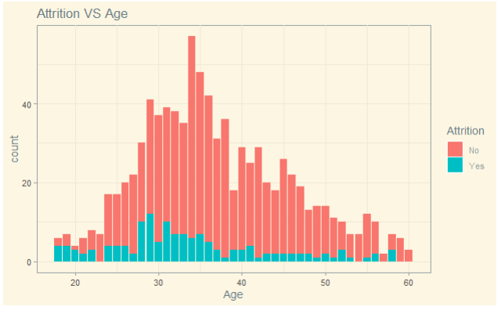
Age

Slide 7
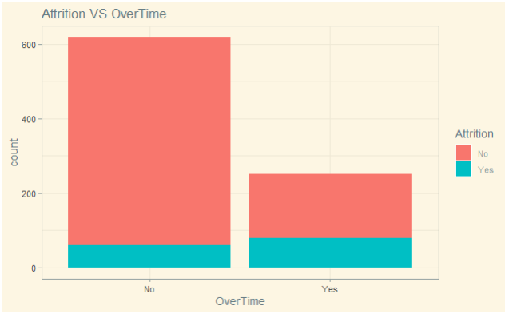
Over Time
~ 10%
~ 30%

Slide 8
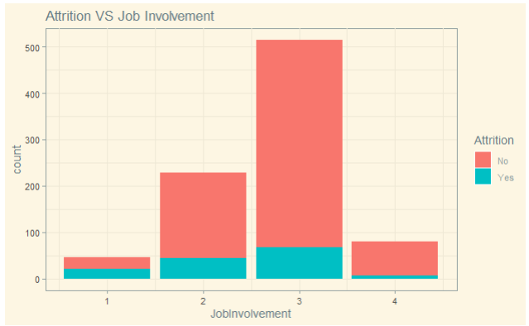
Job Involvements

Slide 9
Prediction Model
KNN
Naïve Bayes
Accuracy | Sensitivity | Specificity
0.7625 | 0.7788 | 0.6571

Slide 10

Salary- Top 3 Factors
Total working year
Age
Job Level

Slide 11
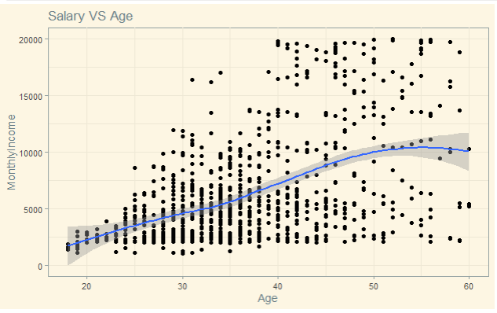
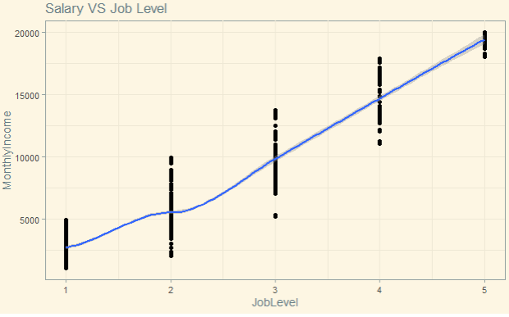
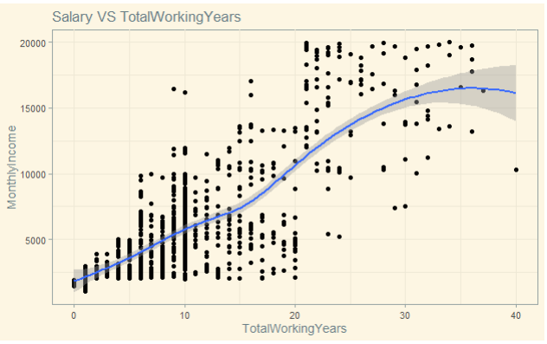
Total working Year, Monthly Income, and Job Level

Slide 12
Prediction Model
Linear Regression Model
RMSE~1362

Slide 13
Thank you
Pejal Rath
prath@mail.smu.edu
YouTube: https://youtu.be/_RbRTrlz66s
ShinyApp: https://prath.shinyapps.io/Project2/

